Slide 1
Coffee Sales & Financial Dashboard
SANSKRITI RAI
sanskritirai1203@gmail.com

Slide 2
Objective & Dataset Description
Objective of Dashboard
Provide business stakeholders with an interactive view of sales, profit, and inventory metrics across different product lines, regions, and states to make informed decisions.
Dataset Description
Source: Coffee Chain Sales Dataset (source: Coffee Chain Sales Analysis)
Time Period: 2012 – 2015
Metrics In The Dataset: Area Code, Cost Of Goods Sold, Profit Gap: Target Vs Actual, Date, Inventory Margin, Profit Margin Percent, Market Size Category, Market Region, Product Line, Product Type, Product Name, Profit, Sales Volume, State, Target COGS, Target Margin Percent, Target Profit, Target Sales Volume, Total Expenses, Product Category.
Calculated Merics From The Dataset: COGS Performance Percent, Profit Achievement Percent, Sales Achievement Percent.

Slide 3
KPI Definitions
Sales Volume: Total units sold
Profit: Revenue after deducting costs
Total Expenses: Operating and production expenses
Profit Achievement %: (Actual Profit / Target Profit) * 100
COGS Performance: Ratio of actual to target cost of goods sold
Inventory Margin: Difference between product value and cost

Slide 4
Features Of Dashboard
Slicers for interactivity (Year, Region, Product Category)
KPIs at the top for at-a-glance overview
Time-series line charts
Pie and treemap for product line and market size
Bar graphs for profit by state and inventory metrics

Slide 5
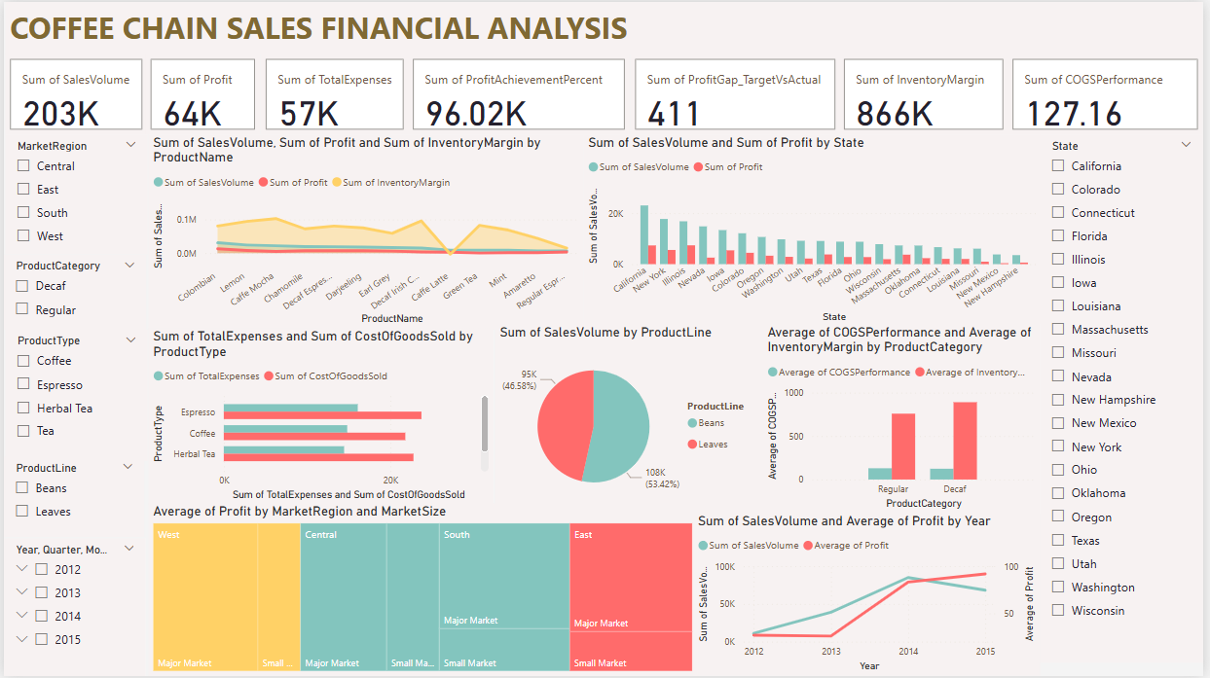
Snapshots Of the Dashboard
GITHUB REPO of the Dashboard.

Slide 6
Insights Summary
Beans outperform Leaves in overall sales volume by 7%.
West region leads in average profit, especially in Major Markets.
California and New York contribute the most to profit.
Decaf category shows higher inventory margins and lower COGS than Regular Category.
2014 was the Best Year in terms of Sales Volume and Profit.

Slide 7
Next Steps / Recommendations
Focus on understanding what went wrong in 2015.
Reallocate inventory to high-performing states (e.g., California, New York).
Review COGS in Regular category to improve profitability.
Explore pricing and promotion strategies in underperforming regions.
Build monthly forecasts using dashboard data trends.

